Slide 1
OpenGL
Uniform blocks and uniform buffers
Advanced Graphics Programming

Slide 2
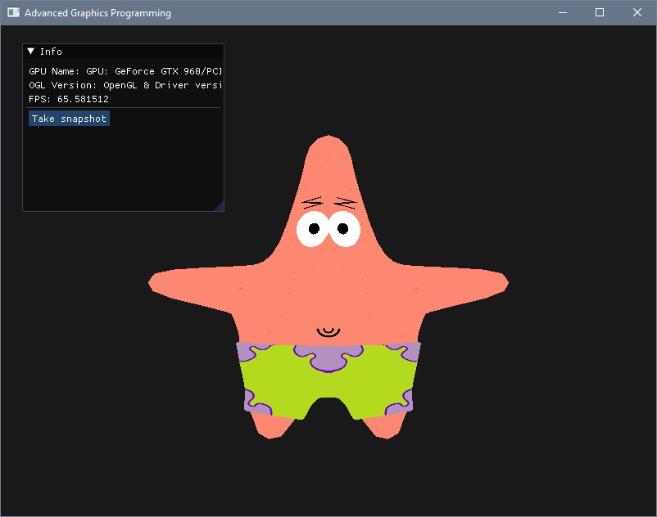
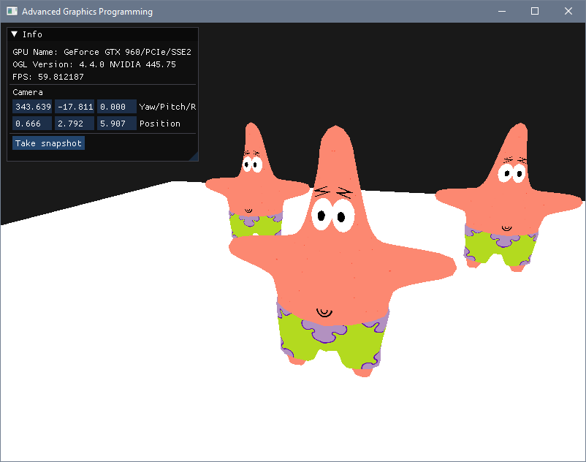
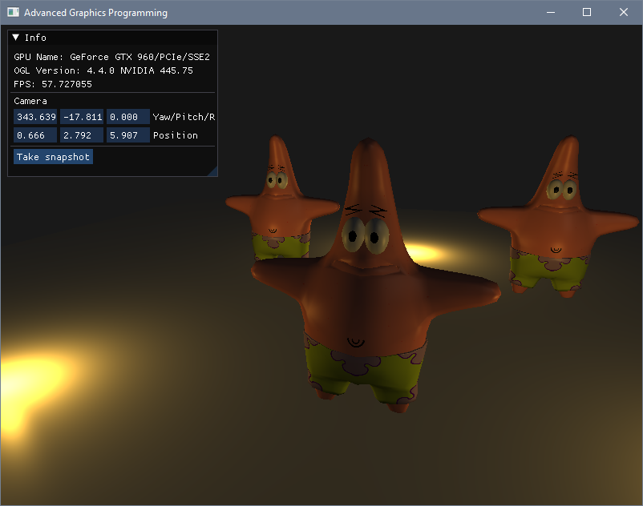
We will add transforms, then lights

Slide 3
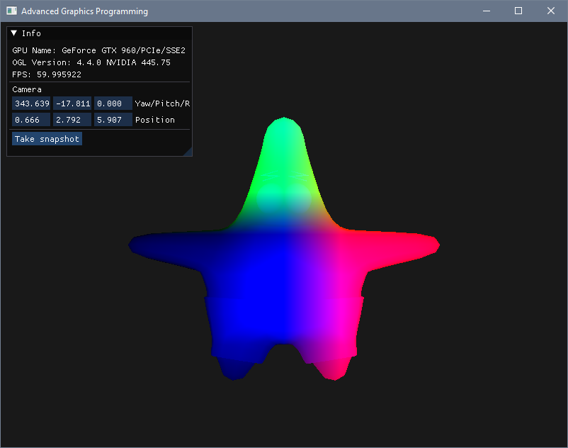
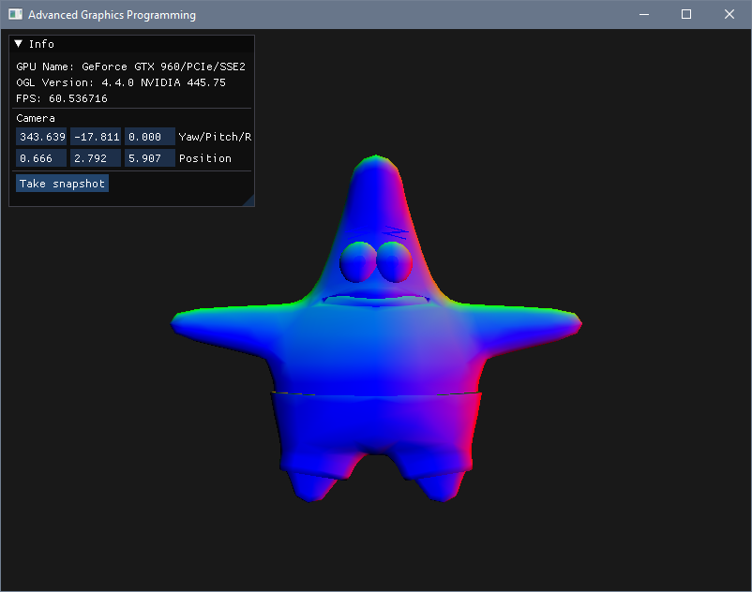


Make sure to pass attributes VS -> FS
Vertex shader outputs...
are fragment shader inputs

Slide 4
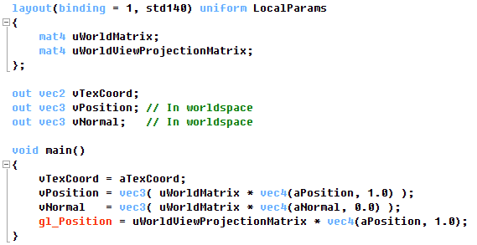
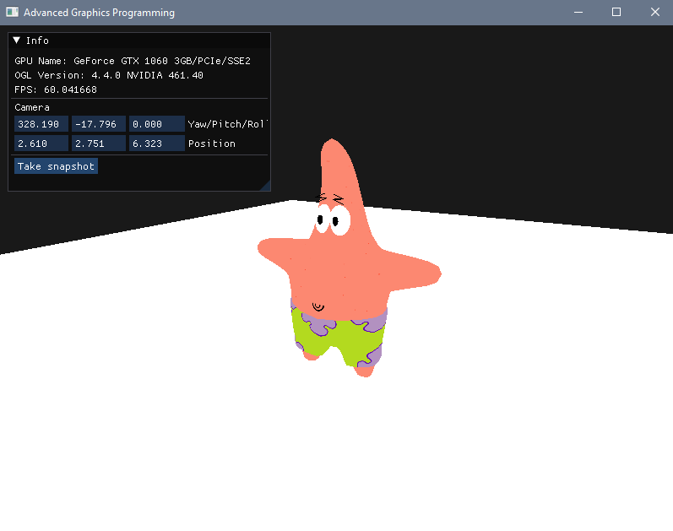
Uniform blocks
Vertex shader
Uniform blocks define a data layout to provide input constants to shaders.
In this case, LocalParams defines an interface to pass per-draw-call inputs.

Slide 5
Uniform buffer bindings
Uniform buffer bindings
Vertex shader
Binding 0
Binding 1
Binding 2
Binding 3
Binding 4
...

Slide 6
Uniform buffer bindings
Uniform buffer bindings
Vertex shader
Uniform buffer
Binding 0
Binding 1
Binding 2
Binding 3
Binding 4
Buffer range
...

Slide 7
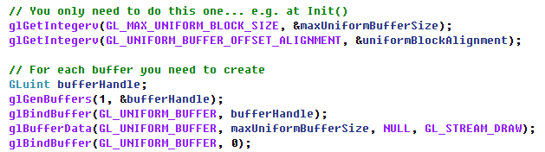
Creating uniform buffers
At initialization, we retrieve the maximum size allowed for uniform buffers, the alignment for each data block we will insert, and create some uniform buffer.
Uniform buffer

Slide 8



Filling uniform buffers
Uniform block in the vertex shader
We have to push data into the buffer ordered according to the uniform block
mat4
mat4
You can fill the buffer once per Update(), for example

Slide 9
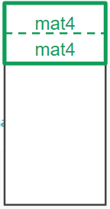
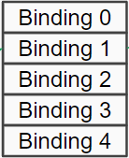
Binding buffer ranges to uniform blocks
Uniform block in the vertex shader
We know where the information is in the buffer, so we bind the known buffer range (offset and size) to the corresponding binding point.
This example is easy because we only have data for one single block in the buffer (so offset is 0), but when we will have data for several blocks… we will need to do some bookkeeping.

Slide 11

What about having several entities?

Slide 12
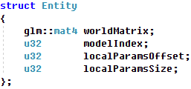
List of entities
At this point you should have a list of entities (or similar).
You will have to copy each entity’s matrices into the uniform buffer.
For each entity, you will need to remember where its information is in the buffer.
mat4
mat4

Slide 13
List of entities
You will have to copy all matrices in the buffer
mat4
mat4
mat4
mat4
mat4
mat4
For each entity
{
entity.localParamsOffset = bufferHead;
entity.localParamsSize = bufferHead - entity.localParamsOffset;
}

Slide 14
List of entities
You will have to copy all matrices in the buffer
mat4
mat4
mat4
mat4
Each shader block needs to be aligned!!!
mat4
mat4
For each entity
{
entity.localParamsOffset = bufferHead;
entity.localParamsSize = bufferHead - entity.localParamsOffset;
}

Slide 15

List of entities
But don’t forget to align each shader block
mat4
mat4
mat4
mat4
For each entity
{
bufferHead = Align(bufferHead, uniformBlockAlignment);
entity.localParamsOffset = bufferHead;
mat4
mat4
entity.localParamsSize = bufferHead - entity.localParamsOffset;
}

Slide 16
List of entities

Slide 17

You think that alignment stuff was difficult?

Slide 18
Shader block member alignment
Speaking about alignment, if we start filling a buffer from offset 0 with values of type mat4… we are lucky, it is a type that works ‘out of the box’ (vec4 too)
mat4
mat4

Slide 19
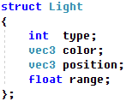
Shader block member alignment
But we cannot generalize. In shader blocks, memory alignment does not work as in a C++ program.
Int
Vec3
Vec3
float
Int
Vec3
Vec3
float
padding
padding
Alignment in main memory
Alignment in video memory

Slide 20
Uniform block layouts
Packed. Platform dependent. Offsets need to be queried. Equal block descriptions can have different offsets on different shaders (cannot be shared). Most performance/memory efficient.
Shared. Platform dependent. Offsets need to be queried. Equal block descriptions will have equal offsets on different shaders (can be shared). Also very performance/memory efficient.
Std140. Platform independent. Layout rules are explicit, so we know the offsets following the layout rules. Quite performance efficient. Not memory efficient.
Std430. Platform independent. Layout rules are explicit, so we know the offsets following the layout rules. Less performance efficient than std140. More memory efficient in arrays.

Slide 21
Next day more on uniform buffers and lights

Slide 22
TODO list
Add the transforms for a single entity
Adapt the vertex shader to use a uniform shader block that contains transform matrices
In Init(): Create a uniform buffer where we will store the shader block values
In Update(): Push the world transform and the world-view-projection of our entity into the buffer
In Render(): Bind the buffer range that contains the two matrices to the shader block
Extend the work for multiple entities
Create a Entity struct and a list of entities in your application (insert a few entities at Init)
Adapt Update() to push the transforms for several entities (take into account block alignment)
Adapt Render() to iterate over all entities and bind the appropriate buffer range each time

Slide 23


